Slide 1
Chapter 9 – Software Evolution
Lecture 1
Chapter 9 Software evolution
<number>

Slide 2
Topics covered
Evolution processes
Change processes for software systems
Program evolution dynamics
Understanding software evolution
Software maintenance
Making changes to operational software systems
Legacy system management
Making decisions about software change
Chapter 9 Software evolution
<number>

Slide 3
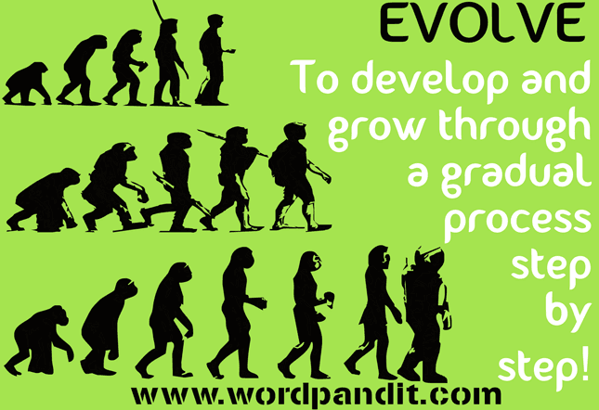
Evolution
“The process by which different kinds of living organism are believed to have developed from earlier forms during the history of the earth”. This is biological evolution.
The gradual development of something.

Slide 4
Software Evolution
In software engineering, software evolution is referred to as the process of developing, maintaining and updating software for various reasons.

Slide 5
Software Failure
Billions of $ per year wasted on preventable mistakes
Biggest tragedy : software failure is mostly predictable and avoidable.
Organisations don't see preventing failure as important

Slide 6
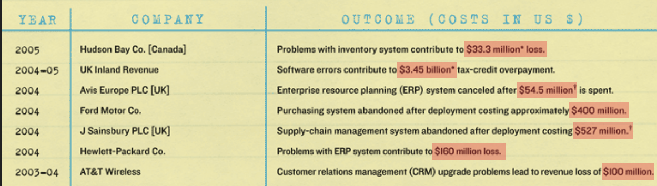
Examples of Software Failures
http://spectrum.ieee.org/computing/software/why-software-fails

Slide 7
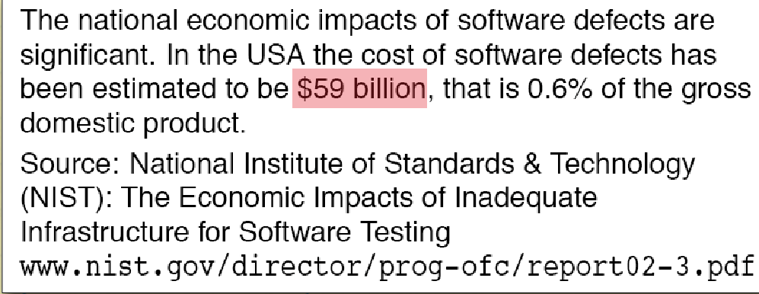

Slide 8
Software change
Software change is inevitable
New requirements emerge when the software is used;
The business environment changes;
Errors must be repaired;
New computers and equipment is added to the system;
The performance or reliability of the system may have to be improved.
A key problem for all organizations is implementing and managing change to their existing software systems.
Chapter 9 Software evolution
<number>

Slide 9
Importance of evolution
Organisations have huge investments in their software systems - they are critical business assets.
To maintain the value of these assets to the business, they must be changed and updated.
The majority of the software budget in large companies is devoted to changing and evolving existing software rather than developing new software.
Chapter 9 Software evolution
<number>

Slide 10
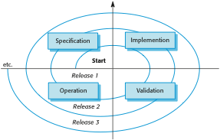
A spiral model of development and evolution
Chapter 9 Software evolution
<number>

Slide 11

Evolution and servicing
Chapter 9 Software evolution
<number>

Slide 12
Evolution and servicing
Evolution
The stage in a software system’s life cycle where it is in operational use and is evolving as new requirements are proposed and implemented in the system.
Servicing
At this stage, the software remains useful but the only changes made are those required to keep it operational i.e. bug fixes and changes to reflect changes in the software’s environment. No new functionality is added.
Phase-out
The software may still be used but no further changes are made to it.
Chapter 9 Software evolution
<number>

Slide 13
Evolution processes
Software evolution processes depend on
The type of software being maintained;
The development processes used;
The skills and experience of the people involved.
Proposals for change are the driver for system evolution.
Should be linked with components that are affected by the change, thus allowing the cost and impact of the change to be estimated.
Change identification and evolution continues throughout the system lifetime.
Chapter 9 Software evolution
<number>

Slide 14
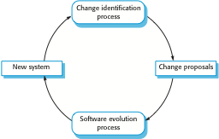
Change identification and evolution processes
Chapter 9 Software evolution
<number>

Slide 15
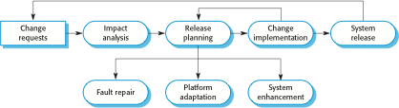
The software evolution process
Chapter 9 Software evolution
<number>

Slide 16

Change implementation
Chapter 9 Software evolution
<number>

Slide 17
Change implementation
Iteration of the development process where the revisions to the system are designed, implemented and tested.
A critical difference is that the first stage of change implementation may involve program understanding, especially if the original system developers are not responsible for the change implementation.
During the program understanding phase, you have to understand how the program is structured, how it delivers functionality and how the proposed change might affect the program.
Chapter 9 Software evolution
<number>

Slide 18
Urgent change requests
Urgent changes may have to be implemented without going through all stages of the software engineering process
If a serious system fault has to be repaired to allow normal operation to continue;
If changes to the system’s environment (e.g. an OS upgrade) have unexpected effects;
If there are business changes that require a very rapid response (e.g. the release of a competing product).
Chapter 9 Software evolution
<number>

Slide 19
The emergency repair process
Chapter 9 Software evolution
<number>

Slide 20
Agile methods and evolution
Agile methods are based on incremental development so the transition from development to evolution is a seamless one.
Evolution is simply a continuation of the development process based on frequent system releases.
Automated regression testing is particularly valuable when changes are made to a system.
Changes may be expressed as additional user stories.
Chapter 9 Software evolution
<number>

Slide 21
Handover problems
Where the development team have used an agile approach but the evolution team is unfamiliar with agile methods and prefer a plan-based approach.
The evolution team may expect detailed documentation to support evolution and this is not produced in agile processes.
Where a plan-based approach has been used for development but the evolution team prefer to use agile methods.
The evolution team may have to start from scratch developing automated tests and the code in the system may not have been refactored and simplified as is expected in agile development.
Chapter 9 Software evolution
<number>

Slide 22
Program evolution dynamics
Program evolution dynamics is the study of the processes of system change.
After several major empirical studies, Lehman and Belady proposed that there were a number of ‘laws’ which applied to all systems as they evolved.
There are sensible observations rather than laws. They are applicable to large systems developed by large organisations.
It is not clear if these are applicable to other types of software system.
Chapter 9 Software evolution
<number>

Slide 23
Change is inevitable
The system requirements are likely to change while the system is being developed because the environment is changing. Therefore a delivered system won't meet its requirements!
Systems are tightly coupled with their environment. When a system is installed in an environment it changes that environment and therefore changes the system requirements.
Systems MUST be changed if they are to remain useful in an environment.
Chapter 9 Software evolution
<number>

Slide 24
Software Evolution Laws
Lehman has given laws for software evolution. He divided the software into three different categories:
S-type (static-type) - This is a software, which works strictly according to defined specifications and solutions.
The solution and the method to achieve it, both are immediately understood before coding.
The s-type software is least subjected to changes hence this is the simplest of all. For example, calculator program for mathematical computation.
P-type (practical-type) - This is a software with a collection of procedures. This is defined by exactly what procedures can do.
In this software, the specifications can be described but the solution is not obvious instantly. For example, gaming software.
E-type (embedded-type) - This software works closely as the requirement of real-world environment.
This software has a high degree of evolution as there are various changes in laws, taxes etc. in the real world situations. For example, Online trading software.

Slide 25
Lehman’s Laws
Continuing change - An E-type software system must continue to adapt to the real world changes, else it becomes progressively less useful.
Increasing complexity - As an E-type software system evolves, its complexity tends to increase unless work is done to maintain or reduce it.
Conservation of familiarity - The familiarity with the software or the knowledge about how it was developed, why was it developed in that particular manner etc. must be retained at any cost, to implement the changes in the system.
Continuing growth- In order for an E-type system intended to resolve some business problem, its size of implementing the changes grows according to the lifestyle changes of the business.
Reducing quality - An E-type software system declines in quality unless rigorously maintained and adapted to a changing operational environment.
Feedback systems- The E-type software systems constitute multi-loop, multi-level feedback systems and must be treated as such to be successfully modified or improved.
Self-regulation -Program evolution is a self-regulating process. System attributes such as size, time between releases, and the number of reported errors is approximately invariant for each system release.
Organizational stability - Over a program’s lifetime, its rate of development is approximately constant and independent of the resources devoted to system development.

Slide 26
Lehman’s laws
Law | Description
Continuing change | A program that is used in a real-world environment must necessarily change, or else become progressively less useful in that environment.
Increasing complexity | As an evolving program changes, its structure tends to become more complex. Extra resources must be devoted to preserving and simplifying the structure.
Large program evolution | Program evolution is a self-regulating process. System attributes such as size, time between releases, and the number of reported errors is approximately invariant for each system release.
Organizational stability | Over a program’s lifetime, its rate of development is approximately constant and independent of the resources devoted to system development.
Chapter 9 Software evolution
<number>

Slide 27
Lehman’s laws
Law | Description
Conservation of familiarity | Over the lifetime of a system, the incremental change in each release is approximately constant.
Continuing growth | The functionality offered by systems has to continually increase to maintain user satisfaction.
Declining quality | The quality of systems will decline unless they are modified to reflect changes in their operational environment.
Feedback system | Evolution processes incorporate multiagent, multiloop feedback systems and you have to treat them as feedback systems to achieve significant product improvement.
Chapter 9 Software evolution
<number>

Slide 28
Applicability of Lehman’s laws
Lehman’s laws seem to be generally applicable to large, tailored systems developed by large organisations.
Confirmed in early 2000’s by work by Lehman on the FEAST project.
It is not clear how they should be modified for
Shrink-wrapped software products;
Systems that incorporate a significant number of COTS components;
Small organisations;
Medium sized systems.
Chapter 9 Software evolution
<number>

Slide 29
Key points
Software development and evolution can be thought of as an integrated, iterative process that can be represented using a spiral model.
For custom systems, the costs of software maintenance usually exceed the software development costs.
The process of software evolution is driven by requests for changes and includes change impact analysis, release planning and change implementation.
Lehman’s laws, such as the notion that change is continuous, describe a number of insights derived from long-term studies of system evolution.
Chapter 9 Software evolution
<number>

Slide 30
Chapter 9 – Software Evolution
Lecture 2
Chapter 9 Software evolution
<number>

Slide 31
Software maintenance
Modifying a program after it has been put into use.
The term is mostly used for changing custom software. Generic software products are said to evolve to create new versions.
Maintenance does not normally involve major changes to the system’s architecture.
Changes are implemented by modifying existing components and adding new components to the system.
Chapter 9 Software evolution
<number>

Slide 32
Types of maintenance
Maintenance to repair software faults
Changing a system to correct deficiencies in the way meets its requirements.
Maintenance to adapt software to a different operating environment
Changing a system so that it operates in a different environment (computer, OS, etc.) from its initial implementation.
Maintenance to add to or modify the system’s functionality
Modifying the system to satisfy new requirements.
Chapter 9 Software evolution
<number>

Slide 33
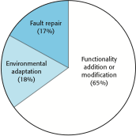
Figure 9.8Maintenance effort distribution
Chapter 9 Software evolution
<number>

Slide 34
Maintenance costs
Usually greater than development costs (2* to 100* depending on the application).
Affected by both technical and non-technical factors.
Increases as software is maintained. Maintenance corrupts the software structure so makes further maintenance more difficult.
Ageing software can have high support costs (e.g. old languages, compilers etc.).
Chapter 9 Software evolution
<number>

Slide 35
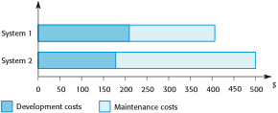
Figure 9.9Development and maintenance costs
Chapter 9 Software evolution
<number>

Slide 36
Maintenance cost factors
Team stability
Maintenance costs are reduced if the same staff are involved with them for some time.
Contractual responsibility
The developers of a system may have no contractual responsibility for maintenance so there is no incentive to design for future change.
Staff skills
Maintenance staff are often inexperienced and have limited domain knowledge.
Program age and structure
As programs age, their structure is degraded and they become harder to understand and change.
Chapter 9 Software evolution
<number>

Slide 37
Maintenance prediction
Maintenance prediction is concerned with assessing which parts of the system may cause problems and have high maintenance costs
Change acceptance depends on the maintainability of the components affected by the change;
Implementing changes degrades the system and reduces its maintainability;
Maintenance costs depend on the number of changes and costs of change depend on maintainability.
Chapter 9 Software evolution
<number>

Slide 38
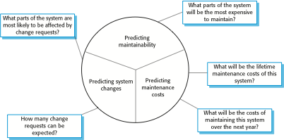
Maintenance prediction
Chapter 9 Software evolution
<number>

Slide 39
Change prediction
Predicting the number of changes requires and understanding of the relationships between a system and its environment.
Tightly coupled systems require changes whenever the environment is changed.
Factors influencing this relationship are
Number and complexity of system interfaces;
Number of inherently volatile system requirements;
The business processes where the system is used.
Chapter 9 Software evolution
<number>

Slide 40
Complexity metrics
Predictions of maintainability can be made by assessing the complexity of system components.
Studies have shown that most maintenance effort is spent on a relatively small number of system components.
Complexity depends on
Complexity of control structures;
Complexity of data structures;
Object, method (procedure) and module size.
Chapter 9 Software evolution
<number>

Slide 41
Process metrics
Process metrics may be used to assess maintainability
Number of requests for corrective maintenance;
Average time required for impact analysis;
Average time taken to implement a change request;
Number of outstanding change requests.
If any or all of these is increasing, this may indicate a decline in maintainability.
Chapter 9 Software evolution
<number>

Slide 42
System re-engineering
Re-structuring or re-writing part or all of a legacy system without changing its functionality.
Applicable where some but not all sub-systems of a larger system require frequent maintenance.
Re-engineering involves adding effort to make them easier to maintain. The system may be re-structured and re-documented.
Chapter 9 Software evolution
<number>

Slide 43
Advantages of reengineering
Reduced risk
There is a high risk in new software development. There may be development problems, staffing problems and specification problems.
Reduced cost
The cost of re-engineering is often significantly less than the costs of developing new software.
Chapter 9 Software evolution
<number>

Slide 44
The reengineering process
Program Documentation
Reengineered Program
Original Data
Original Program
Reverse Engineering
Program Modularization
Data Reengineering
Source code Translation
Restructured Program
Reengineered Data
Program Structure Improvement
Chapter 9 Software evolution
<number>

Slide 45
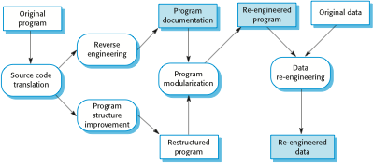
The reengineering process
Chapter 9 Software evolution
<number>

Slide 46
Reengineering process activities
Source code translation
Convert code to a new language.
Reverse engineering
Analyse the program to understand it;
Program structure improvement
Restructure automatically for understandability;
Program modularisation
Reorganise the program structure;
Data reengineering
Clean-up and restructure system data.
Chapter 9 Software evolution
<number>

Slide 47
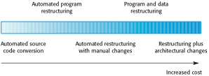
Figure 9.12 Reengineering approaches
Chapter 9 Software evolution
<number>

Slide 48
Reengineering cost factors
The quality of the software to be reengineered.
The tool support available for reengineering.
The extent of the data conversion which is required.
The availability of expert staff for reengineering.
This can be a problem with old systems based on technology that is no longer widely used.
Chapter 9 Software evolution
<number>

Slide 49
Preventative maintenance by refactoring
Refactoring is the process of making improvements to a program to slow down degradation through change.
You can think of refactoring as ‘preventative maintenance’ that reduces the problems of future change.
Refactoring involves modifying a program to improve its structure, reduce its complexity or make it easier to understand.
When you refactor a program, you should not add functionality but rather concentrate on program improvement.
Chapter 9 Software evolution
<number>

Slide 50
Refactoring and reengineering
Re-engineering takes place after a system has been maintained for some time and maintenance costs are increasing. You use automated tools to process and re-engineer a legacy system to create a new system that is more maintainable.
Refactoring is a continuous process of improvement throughout the development and evolution process. It is intended to avoid the structure and code degradation that increases the costs and difficulties of maintaining a system.
Chapter 9 Software evolution
<number>

Slide 51
‘Bad smells’ in program code
Duplicate code
The same or very similar code may be included at different places in a program. This can be removed and implemented as a single method or function that is called as required.
Long methods
If a method is too long, it should be redesigned as a number of shorter methods.
Switch (case) statements
These often involve duplication, where the switch depends on the type of a value. The switch statements may be scattered around a program. In object-oriented languages, you can often use polymorphism to achieve the same thing.
Chapter 9 Software evolution
<number>

Slide 52
‘Bad smells’ in program code
Data clumping
Data clumps occur when the same group of data items (fields in classes, parameters in methods) re-occur in several places in a program. These can often be replaced with an object that encapsulates all of the data.
Speculative generality
This occurs when developers include generality in a program in case it is required in the future. This can often simply be removed.
Chapter 9 Software evolution
<number>

